Slide 1

PROJECT 1: SIR+ MODEL
Computational Thinking II
Presented by Group 1:
Tolu Adeola
Maloney Tutu
Ralph Reyes
Earl Pough

Slide 2
Scenario
On the island, an unknown virus has begun to spread, with one individual already infected. The remaining population is entirely susceptible, with no recoveries recorded so far. There is also the unsettling possibility that the virus could mutate, resulting in the creation of an Intelligent Zombie—an infected person who retains their human memories but is driven by a craving for human flesh.
Here’s what we intially know:
Total population: 50 individuals
Susceptible: 49 individuals
Infected: 1 individual
Recovered: 0 individual
Intelligent Zombies: 0 individual
Infection Rate (α): 0.1
Recovery Rate (β): 0.05
Mutation Rate (γ): 0.02

Slide 3
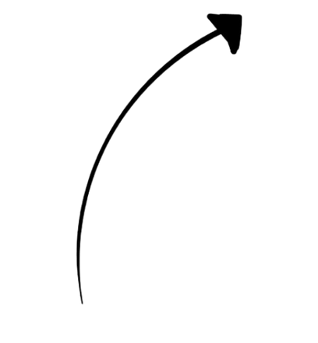
SIIZR Model
-
+
-
+
S
I
R
α
β
-
γ
IZ
+

Slide 4
SIIZR Model Equations
Sₙ = Sₙ₋₁ - (Sₙ₋₁ × α)
Iₙ = Iₙ₋₁ + (Sₙ₋₁ × α) - (Iₙ₋₁ × β) - (Iₙ₋₁ × γ)
Rₙ = Rₙ₋₁ + (Iₙ₋₁ * β)
IZₙ = IZₙ₋₁ + (Iₙ₋₁ * γ)

Slide 5

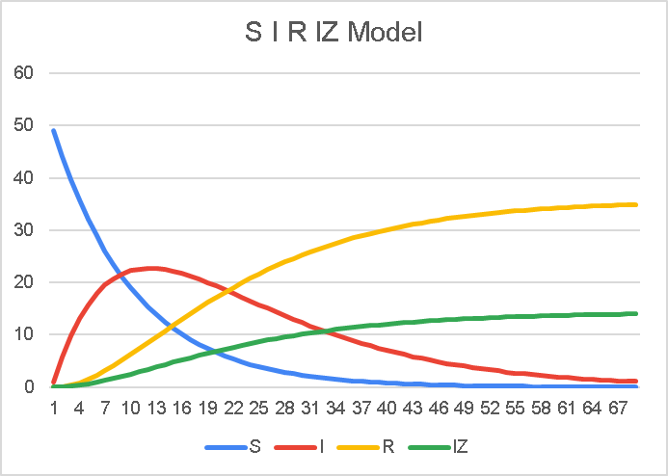
Excel Implementation

Slide 6
How can we reduce our SIR+ Model into the less complicated models?
By setting γ = 0, our SIR+ model naturally reduces to the original SIR model, making it flexible enough to simulate simpler cases.
Sₙ = Sₙ₋₁ - (Sₙ₋₁ * α)
Iₙ = Iₙ₋₁ + (Sₙ₋₁ * α) - (Iₙ₋₁ * β) - (Iₙ₋₁ * 0)
Rₙ = Rₙ₋₁ + (Iₙ₋₁ * β)
IZₙ = IZₙ₋₁ + (Iₙ₋₁ * 0)

Slide 7
Thank you

